Slide 1

ST.ANDREW`S INSTITUTE OF TECHNOLOGY AND MANAGEMENT
PRESENTATION FOR WEB DEVELOPMENT
Roll No:- 229066
Presented By:-
Ravi Kumar Shrivastav

Slide 2
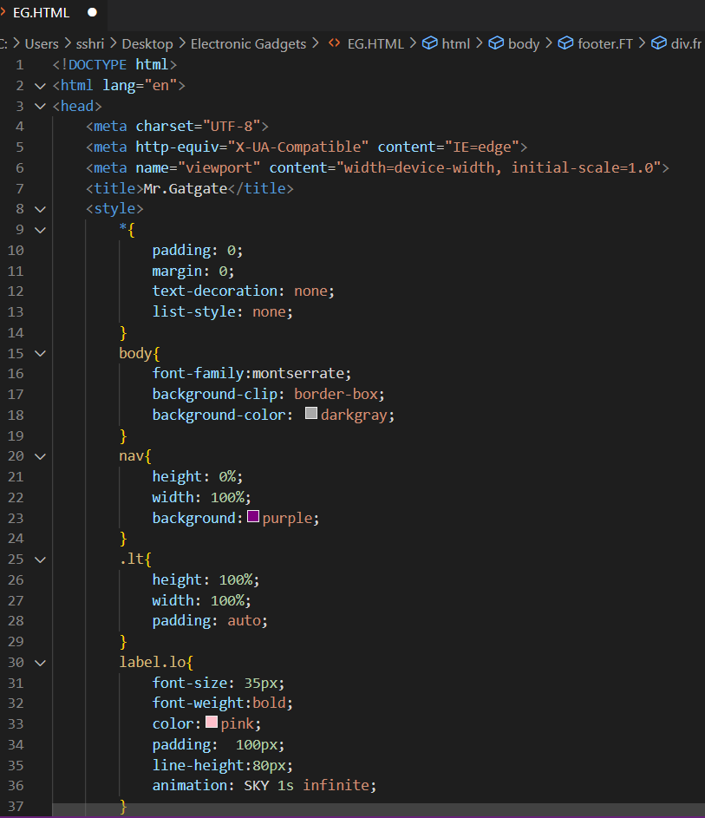
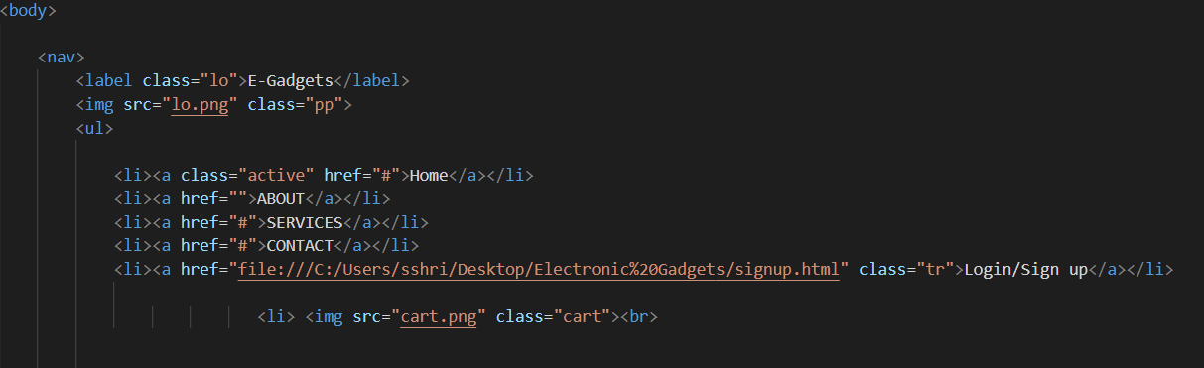
SOURCE CODE
Navbar
CSS
HTML

Slide 3
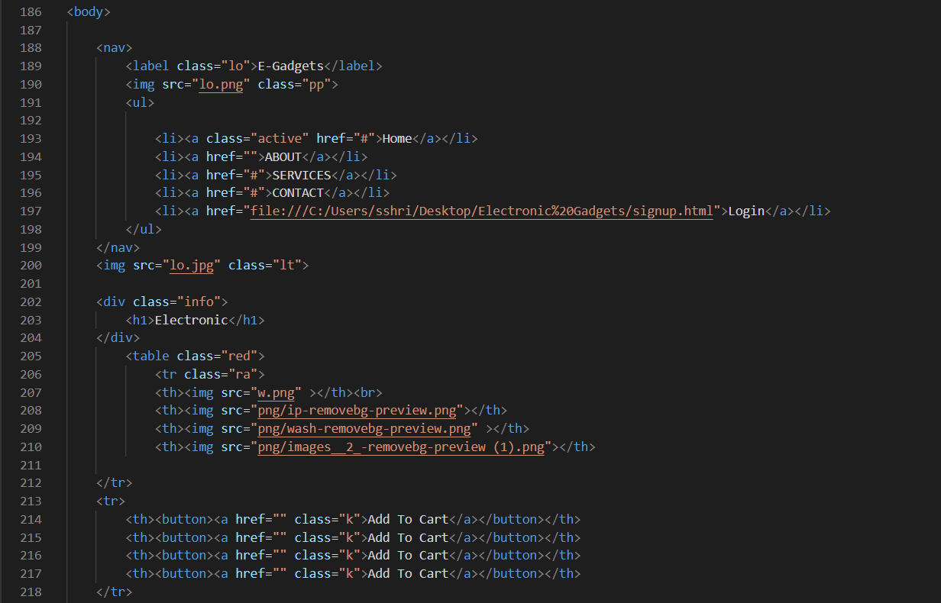
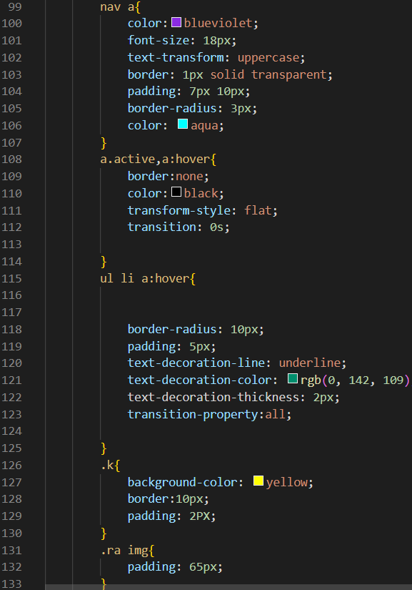

HTML
Nav And Banner
CSS

Slide 4
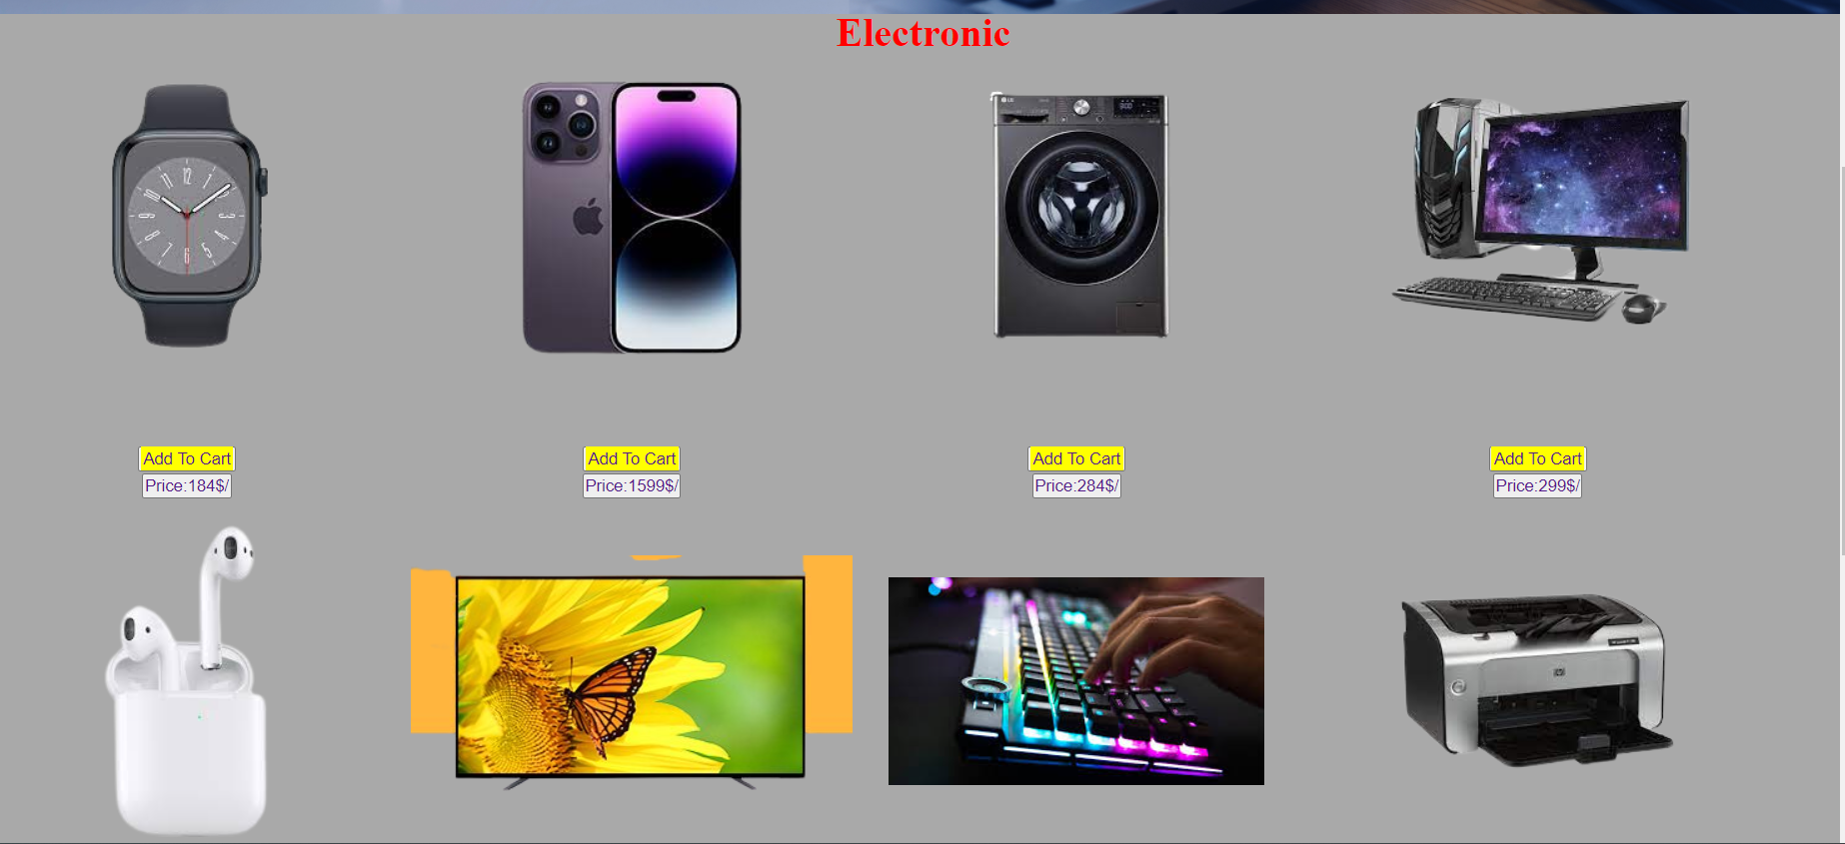
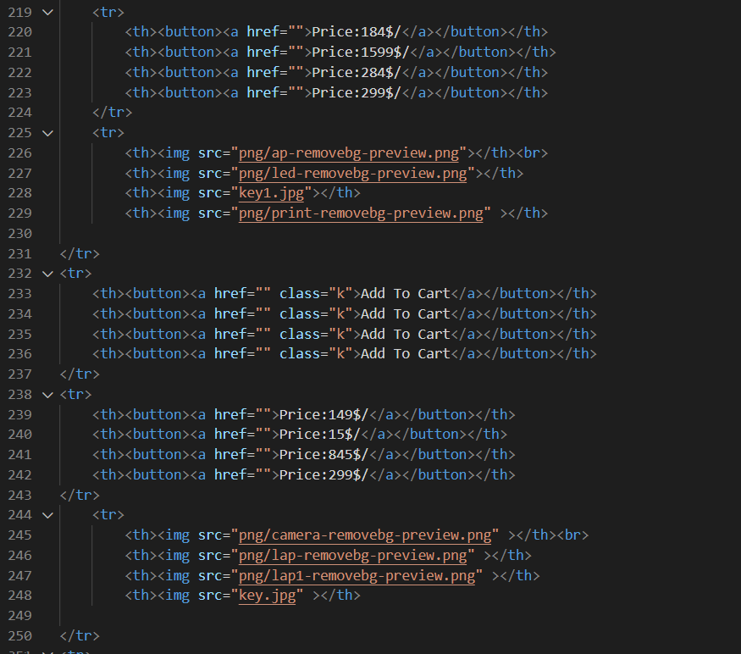
HTML
Products
CSS

Slide 5

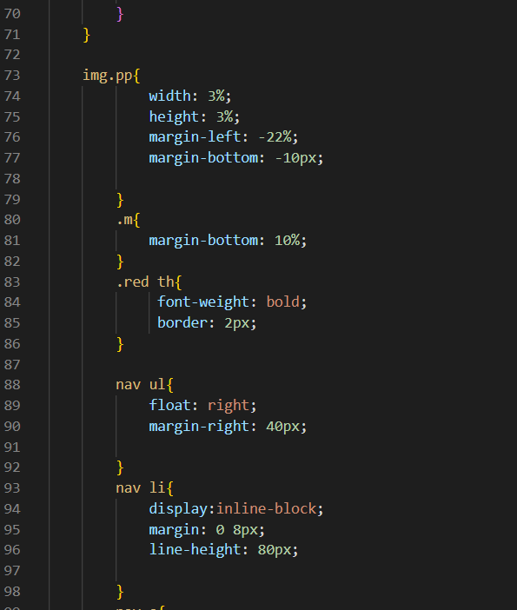
HTML
Products
CSS

Slide 6
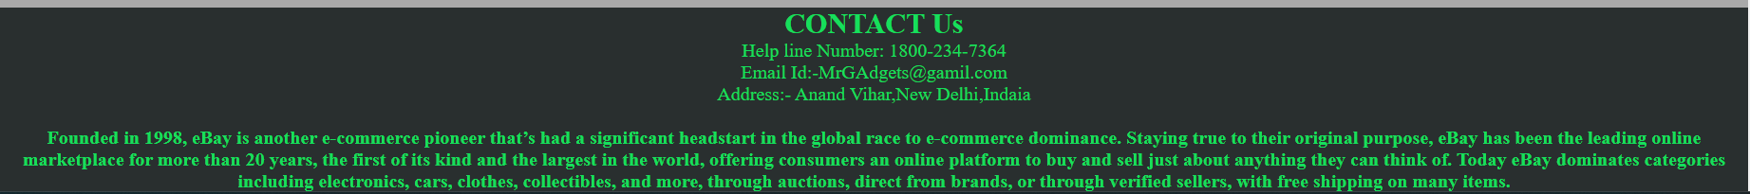
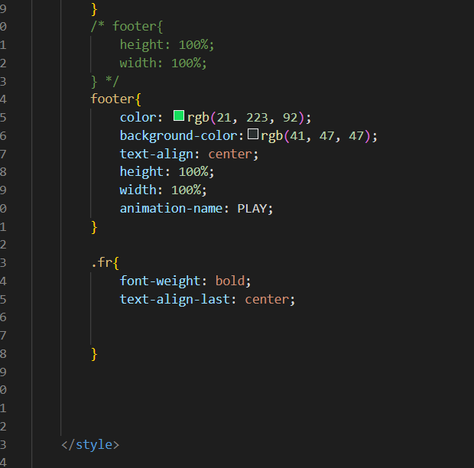
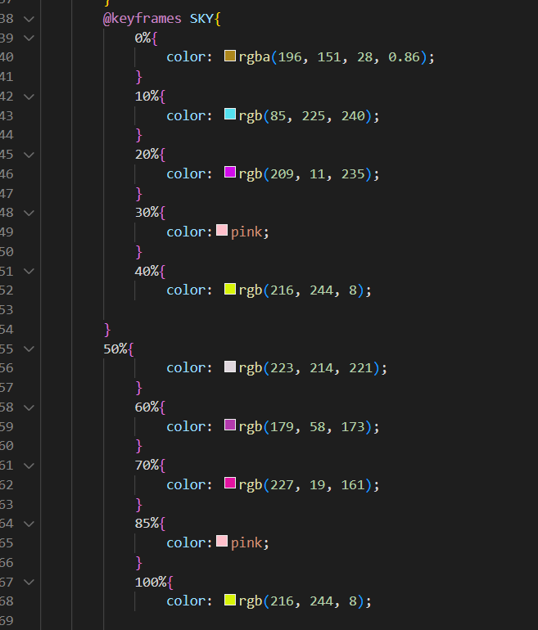
HTML
About
CSS

Slide 7
HTML CODE

Slide 9
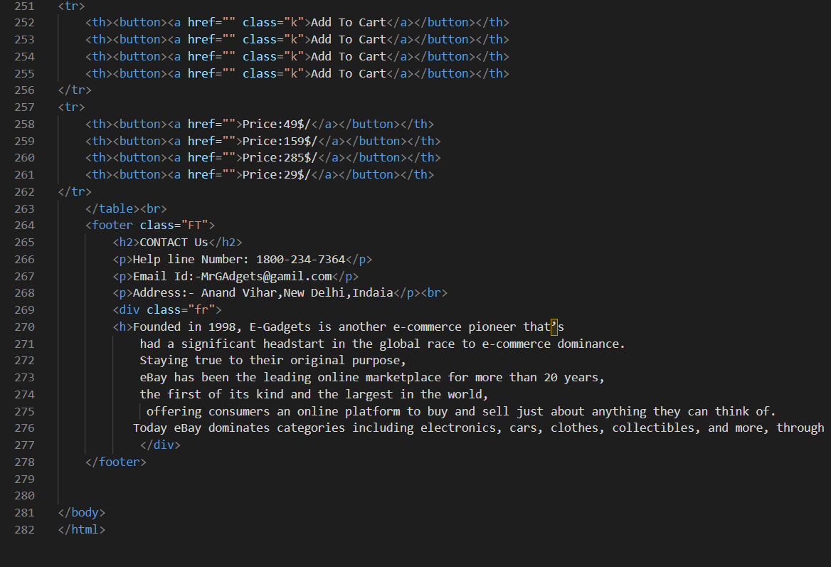

Slide 10
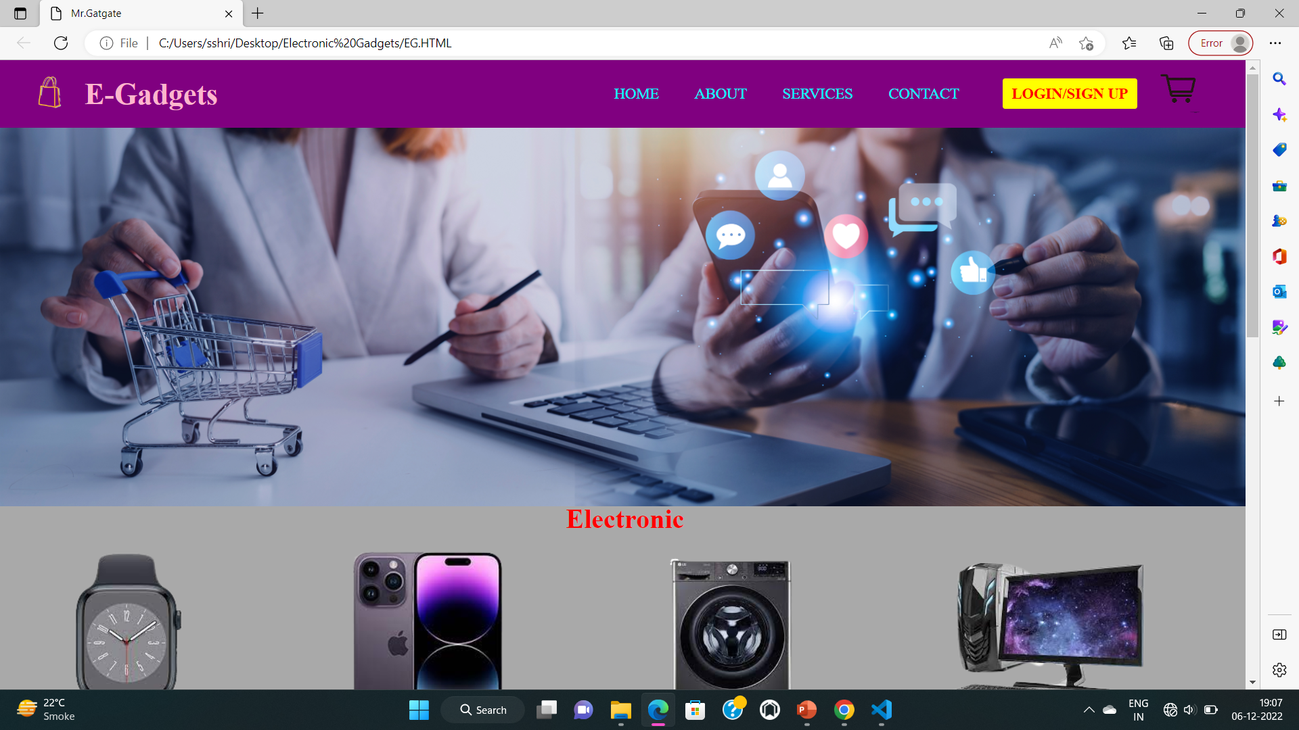

Slide 11
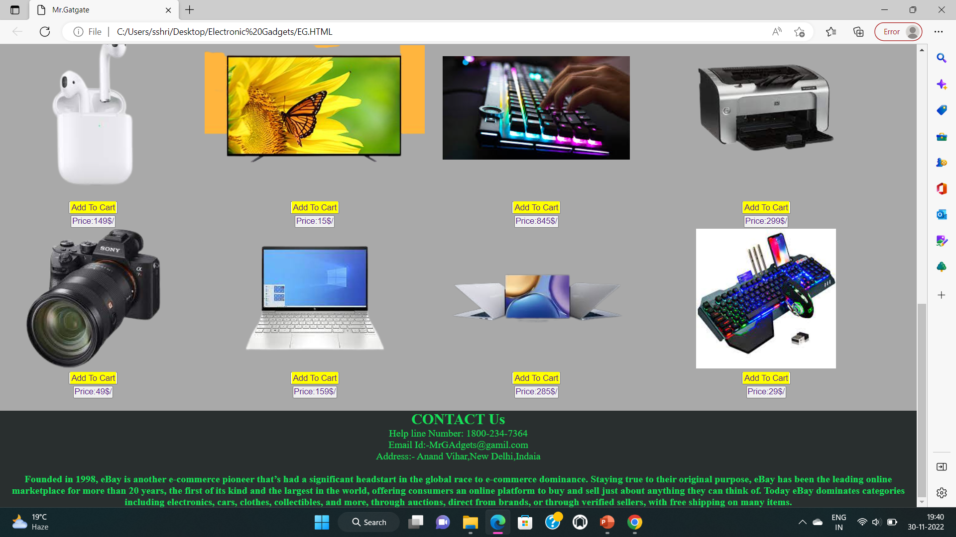

Slide 12
THANK YOU

